Slide 1






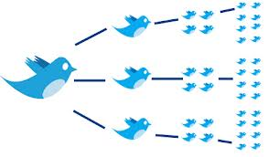



Social Media Analytics Network Centrality Metrics MSBA, Session 2, Jan 26, 2022
Dr. Anitesh Barua
David Bruton Jr. Centennial Chair Professor of Business
Distinguished Fellow, INFORMS Information Systems Society
University of Texas Distinguished Teaching Professor
Associate Director, Center for Research in e-Commerce
McCombs School of Business, University of Texas at Austin
Email: aniteshb@gmail.com

Slide 2
Learning Objectives
How to create a network from conversations
A social network platform’s perspective
How to increase # connections & interactions
Metrics to track such growth
Targeting
A user organization’s perspective
Who are important for our brand or product?
Metrics to rank them
How to pursue them
How networked customers make decisions

Slide 3
How to Create a Network From Conversations: The Case of Twitter
Follower
Friend
You
Follower
Friend
Information
Attention
© Anitesh Barua, 2021

Slide 4
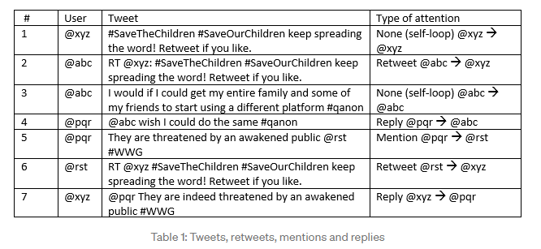
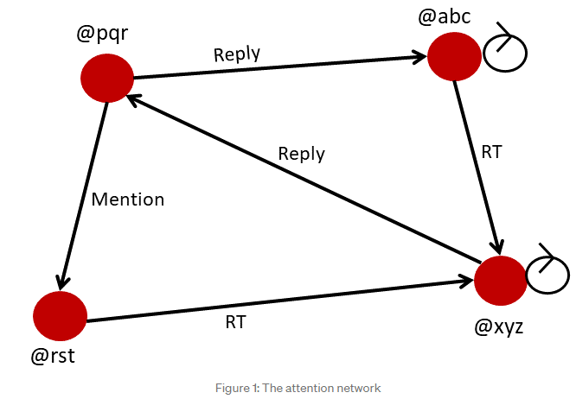
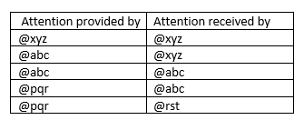
Creating a Network from Tweets
Source: https://towardsdatascience.com/grassroots-or-influencer-driven-a-social-network-analysis-of-the-qanon-conspiracy-theory-f99617f8454d

Slide 5
Describing Your Network to an Advertiser
What metrics can we use to describe the connectedness of the network?
Network-level metrics
Density
Average geodesic
Etc.
Node-level metrics

Slide 6
How Networks Grow: A Reality Check
“If you are friends with Alan, and friends with Betty, then it is likely that Alan and Betty will become friends as well, mostly because they already have something in common: You.”
“You brought a friend to your favorite yoga studio and she started regularly attending class, even when you didn’t go.”
Source: http://plainspokenlinguist.wordpress.com/2013/09/20/i-know-a-guy-the-power-of-triadic-closure/

Slide 7
Predicting Future Links (Edges) With “Triadic Closure”
G
G
B
C
B
C
F
A
F
A
E
D
E
D
“If two people in a social network have a
common friend, then there is an increased
likelihood that they will become friends
themselves at some point in the future”
“People you may know” in FB
G
B
C
F
A
Clustering coefficient of a user: Probability
that two randomly selected friends of the user are
friends with each other.
E
D
Source: Easley & Kleinberg, “Networks Crowds & Markets”

Slide 8
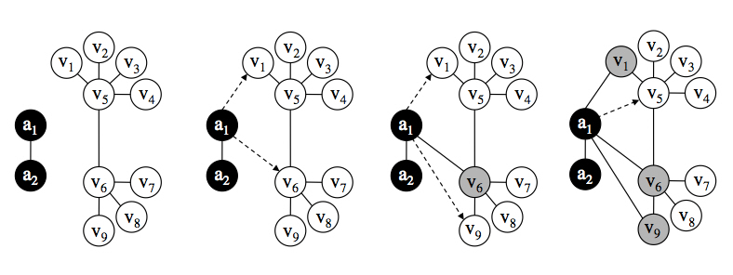
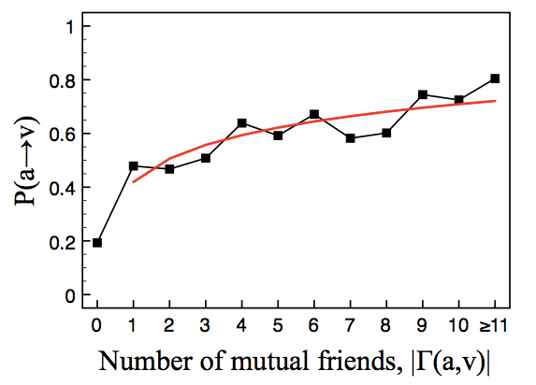
Abusing the Triadic Closure Principle
UBC students wrote code that randomly sends friend requests
If accepted, then …?
8,954 users requested, 3,055 accepted
N(a,v)
Source: http://blogs.cornell.edu/info2040/2011/09/30/abusing-triadic-closure/

Slide 9
Social Network Structure
In addition to getting attention & being active, your position in a network matters
E.g.,
Who are most popular?
Who can spread information quickly?
Who help connect diverse groups?
Need to look into the structure of networks

Slide 10
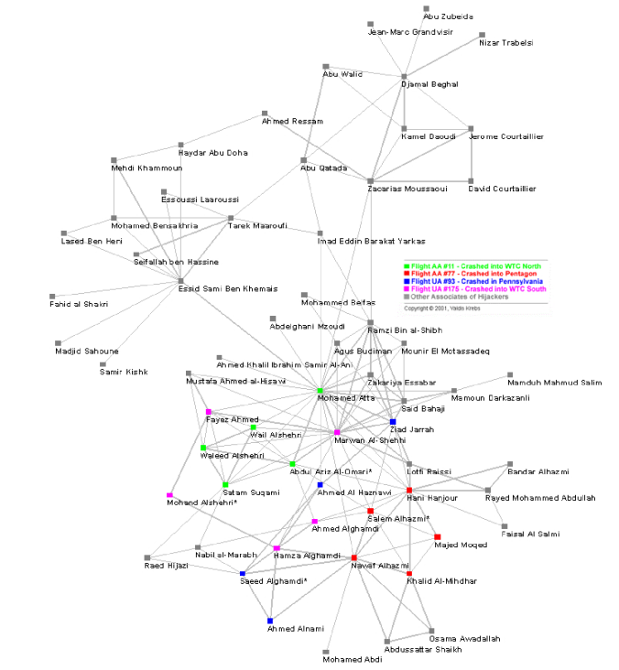
Myriad Applications of Network Analytics: The 911 Terrorist Network
Who are central to the network?
What was the role of M. Atta?
How can we watch out against
future attacks?

Slide 11
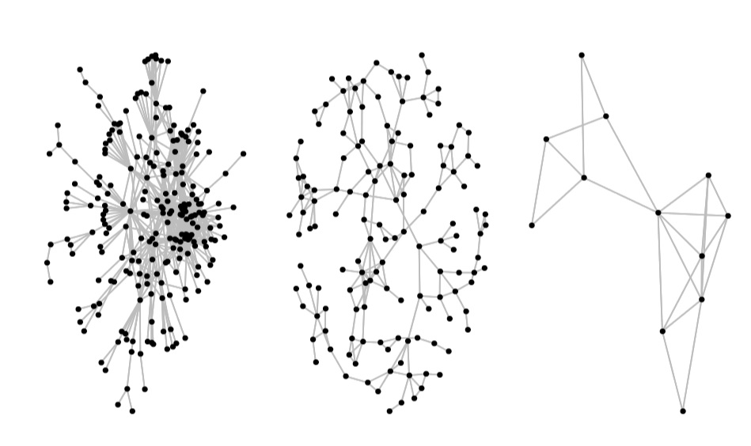
Not All Networks Are Created Equal
How do we summarize the essential properties of these networks?
Source: P. Hoff, U. Washington

Slide 12
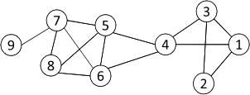
Metric 1: Degree Centrality
Who are most popular? Most connected?
Number of “edges” connected to a “node” or “vertex”
Normalized Degree Centrality: Degree centrality/(n -1)
For node 1, degree centrality is 3;
Normalized degree centrality is
3/(9-1)=3/8.
In-degree and out-degree for directed networks (e.g., Twitter, email, etc.)
Can degree be a useful metric?

Slide 13
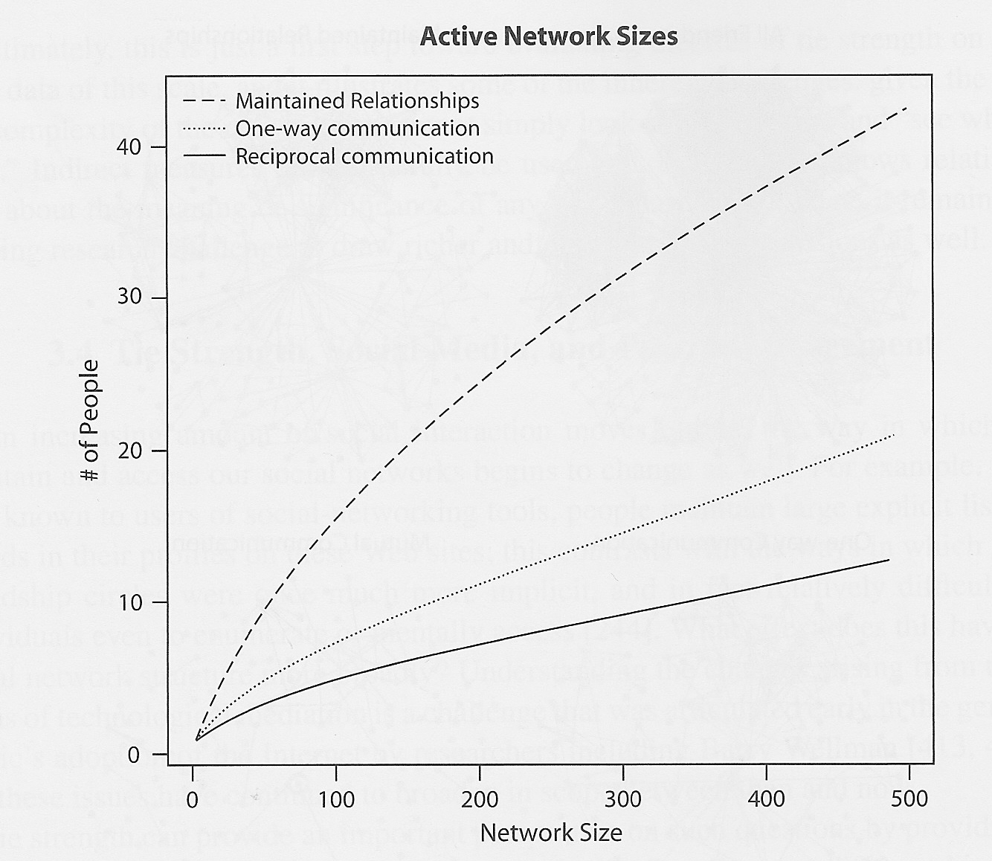
Is Degree a Good Indicator of Activity?
Source: Easley & Kleinberg, “Networks Crowds & Markets”

Slide 14
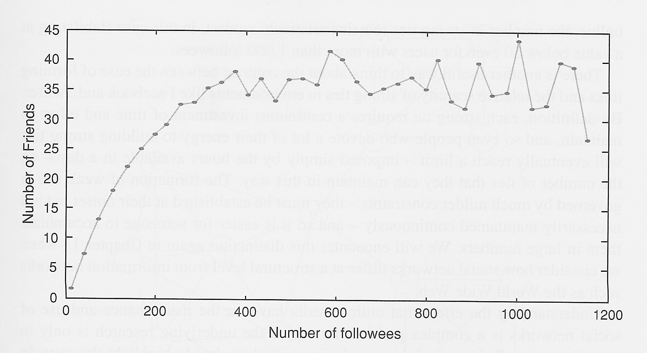
Strength of Ties on Twitter
# people the user has mentioned at least
twice in tweets
(# people you follow)
What can we conclude here?
Source: Easley & Kleinberg, “Networks Crowds & Markets”

Slide 15
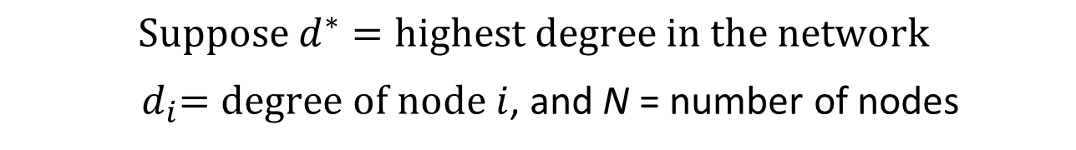
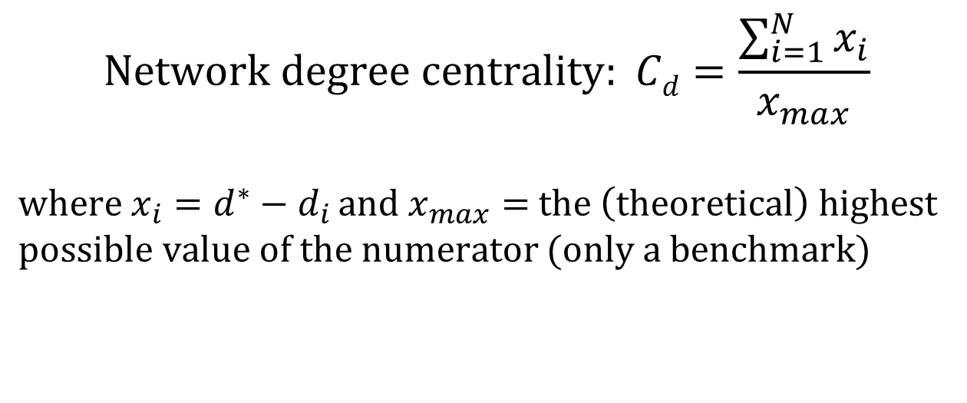
Degree Centrality Metric for the Overall Network
$$Suppose d^{∗}=highest degree in the network$$
${ d}_{i}=degree of node i$, and N = number of nodes
$$Network degree centrality: Cd=\frac{\sum_{i=1}^{N}{x_{i}}}{x_{max}}$$
${where x}_{i}=d^{∗}−d_{i }and x_{max}=$ $the \left(theoretical\right) highest$
$possible value of the numerator$ $(only a benchmark)$
What would the theoretical highest be?
For which type of network?

Slide 16
The Star Network
Star network with n nodes
Degree centrality of central node
= (n-1)

Slide 17
“The Strength of Weak Ties”
Granovetter’s observations on job leads
C
A
B
H
D
E
F
G
A has four friends, but the friendships are different
A, C, D and E probably share “strong” ties
B may belongs to a different, distant world
A-B possibly represents a “weak” tie
But may be a source of new information, ideas or insights
Captured by the “betweenness” centrality metric
Source: Easley & Kleinberg, “Networks Crowds & Markets”

Slide 18
Local Bridges & Their Significance
J
K
L
I
M
C
A
B
H
D
E
F
G
A, B is a local bridge of span 4
Formal definition?
Significance?
Source: Easley & Kleinberg, “Networks Crowds & Markets”

Slide 19
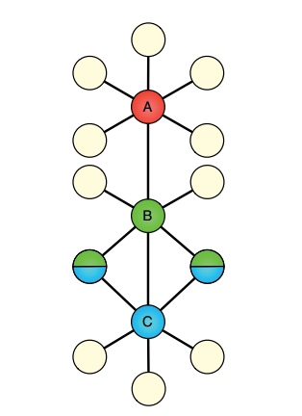
“Smoother” Metrics to Capture Weak/Strong Ties & Local Bridges
What can we use instead of 0/1 for tie strength?
E.g., to understand tie strength in a cell phone network
Can we also redefine local bridges (0/1) to be [0, 1]?
Suggestions?
Significance
What can we say about strength of ties for A-B and B-C?
Source: Easley & Kleinberg, “Networks Crowds & Markets”

